Slide 1
DataLucent User Experience
Version 2.0

Slide 2
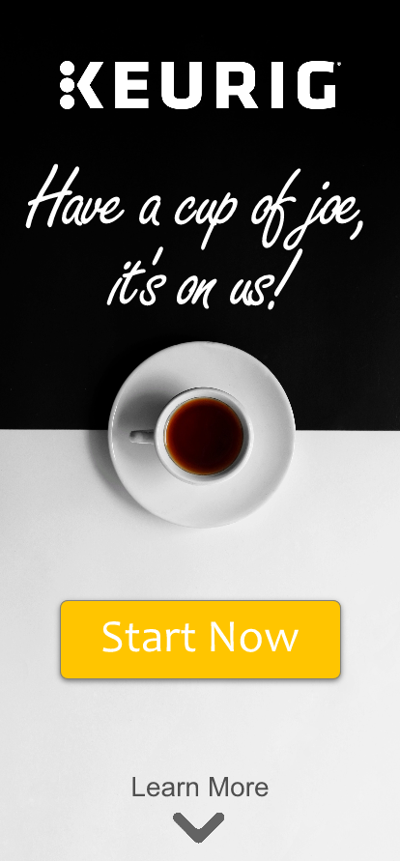
A Warm Welcome
Users are initially greeted with a friendly message and simple to understand interface.
Selecting “Start Now” moves the user to the next step.
They can also select “Learn More” if they’re curious to learn additional information, such as privacy policies or details of the campaign.

Slide 3
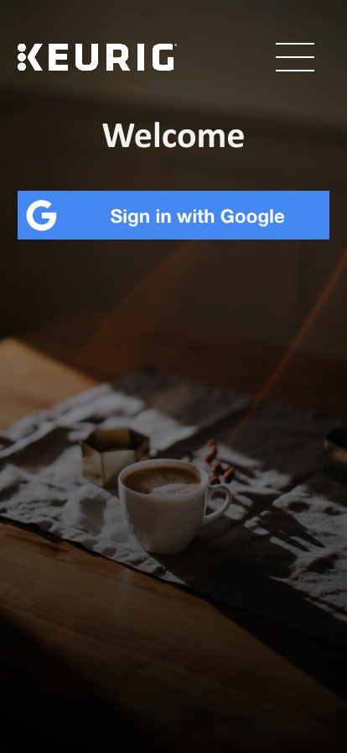
Single Sign On
The user is requested to submit their username and password using OAuth from any popular platform.
In this example, we’re using Google.
When the user submits their login information, it’s sent to our servers which can then act on behalf of the user.

Slide 4
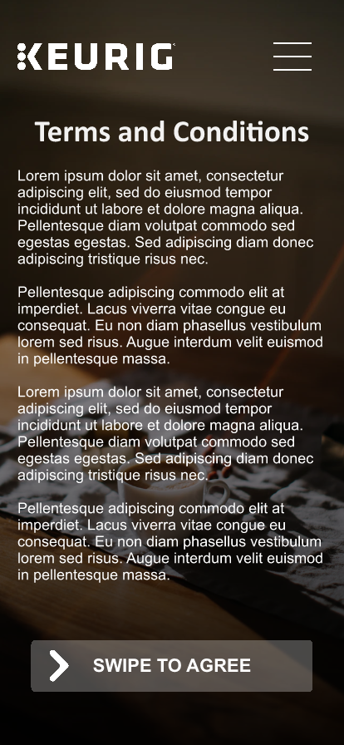
Consent Page
After logging in, the user is brought to the terms and conditions page.
Once the user swipes to agree to the terms, they are immediately brought to the next step.

Slide 5
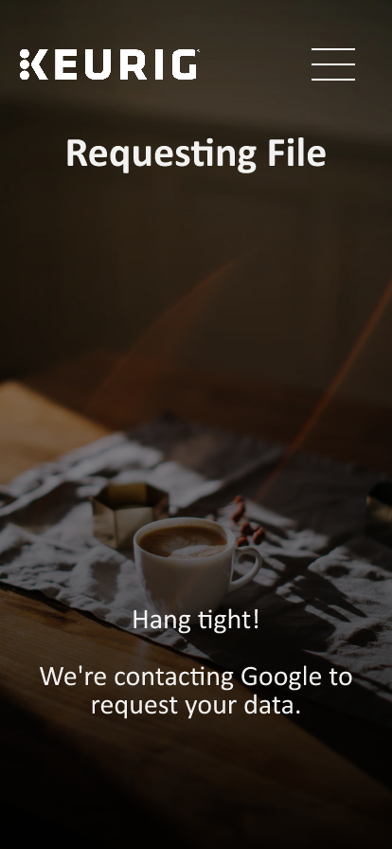
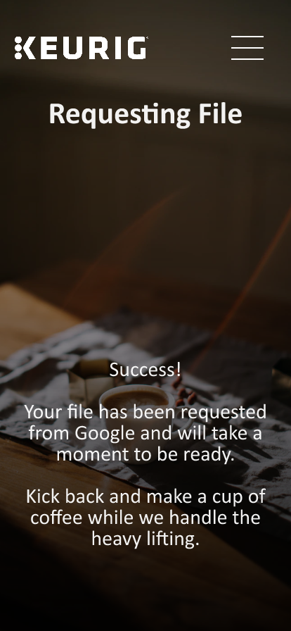

Automated File Request
After consent is obtained, the user is immediately brought to the file request page.
At this point, our servers do the heavy lifting while the user waits. This process is generally very fast and should take under one minute.

Slide 6
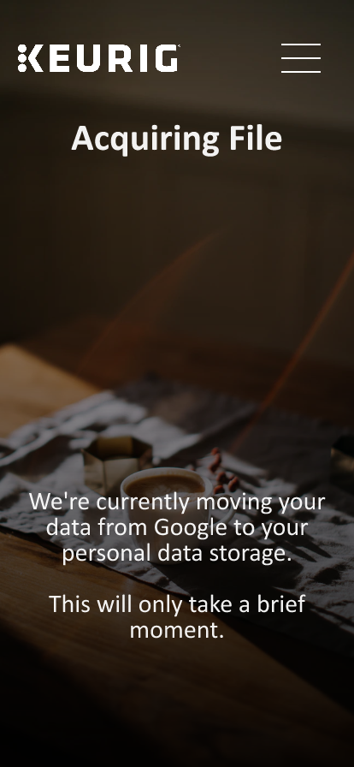
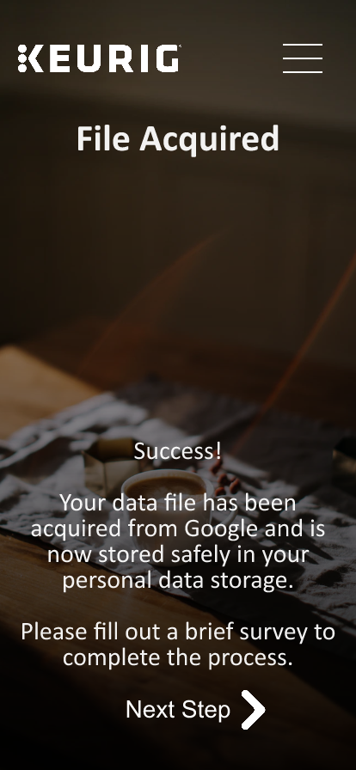
Automated File Acquisition
Once the file is requested, the user can then leave the app.
Each platform and each user will have a different waiting period for the file to become ready.
Our system does not need to contact the user for further interaction; however, we can provide an additional confirmation if desired. The user would receive a push notification that their file was ready and could witness the transfer live. They could also ignore it and allow the transfer to occur automatically.

Slide 7
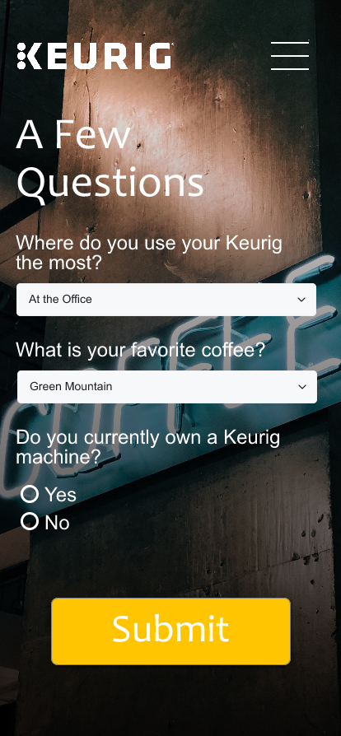
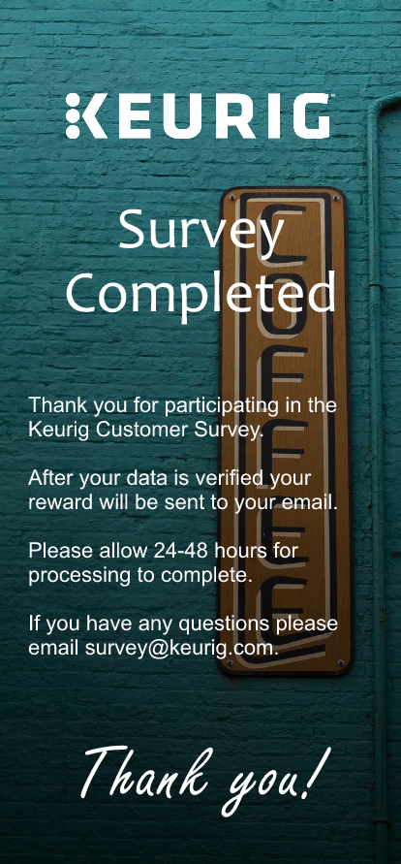
Optional Steps
If desired, a custom survey can be added during any portion of the file acquisition process.
We can also include an optional thank you page at the end that explains a bit of information to the user.
Please keep in mind that this new solution can be tailored to suit any amount of text, explanation of process, and/or resources that Keurig desires.
With our new automated file acquisition system, the app design is truly in the palm of our customers.

Slide 8
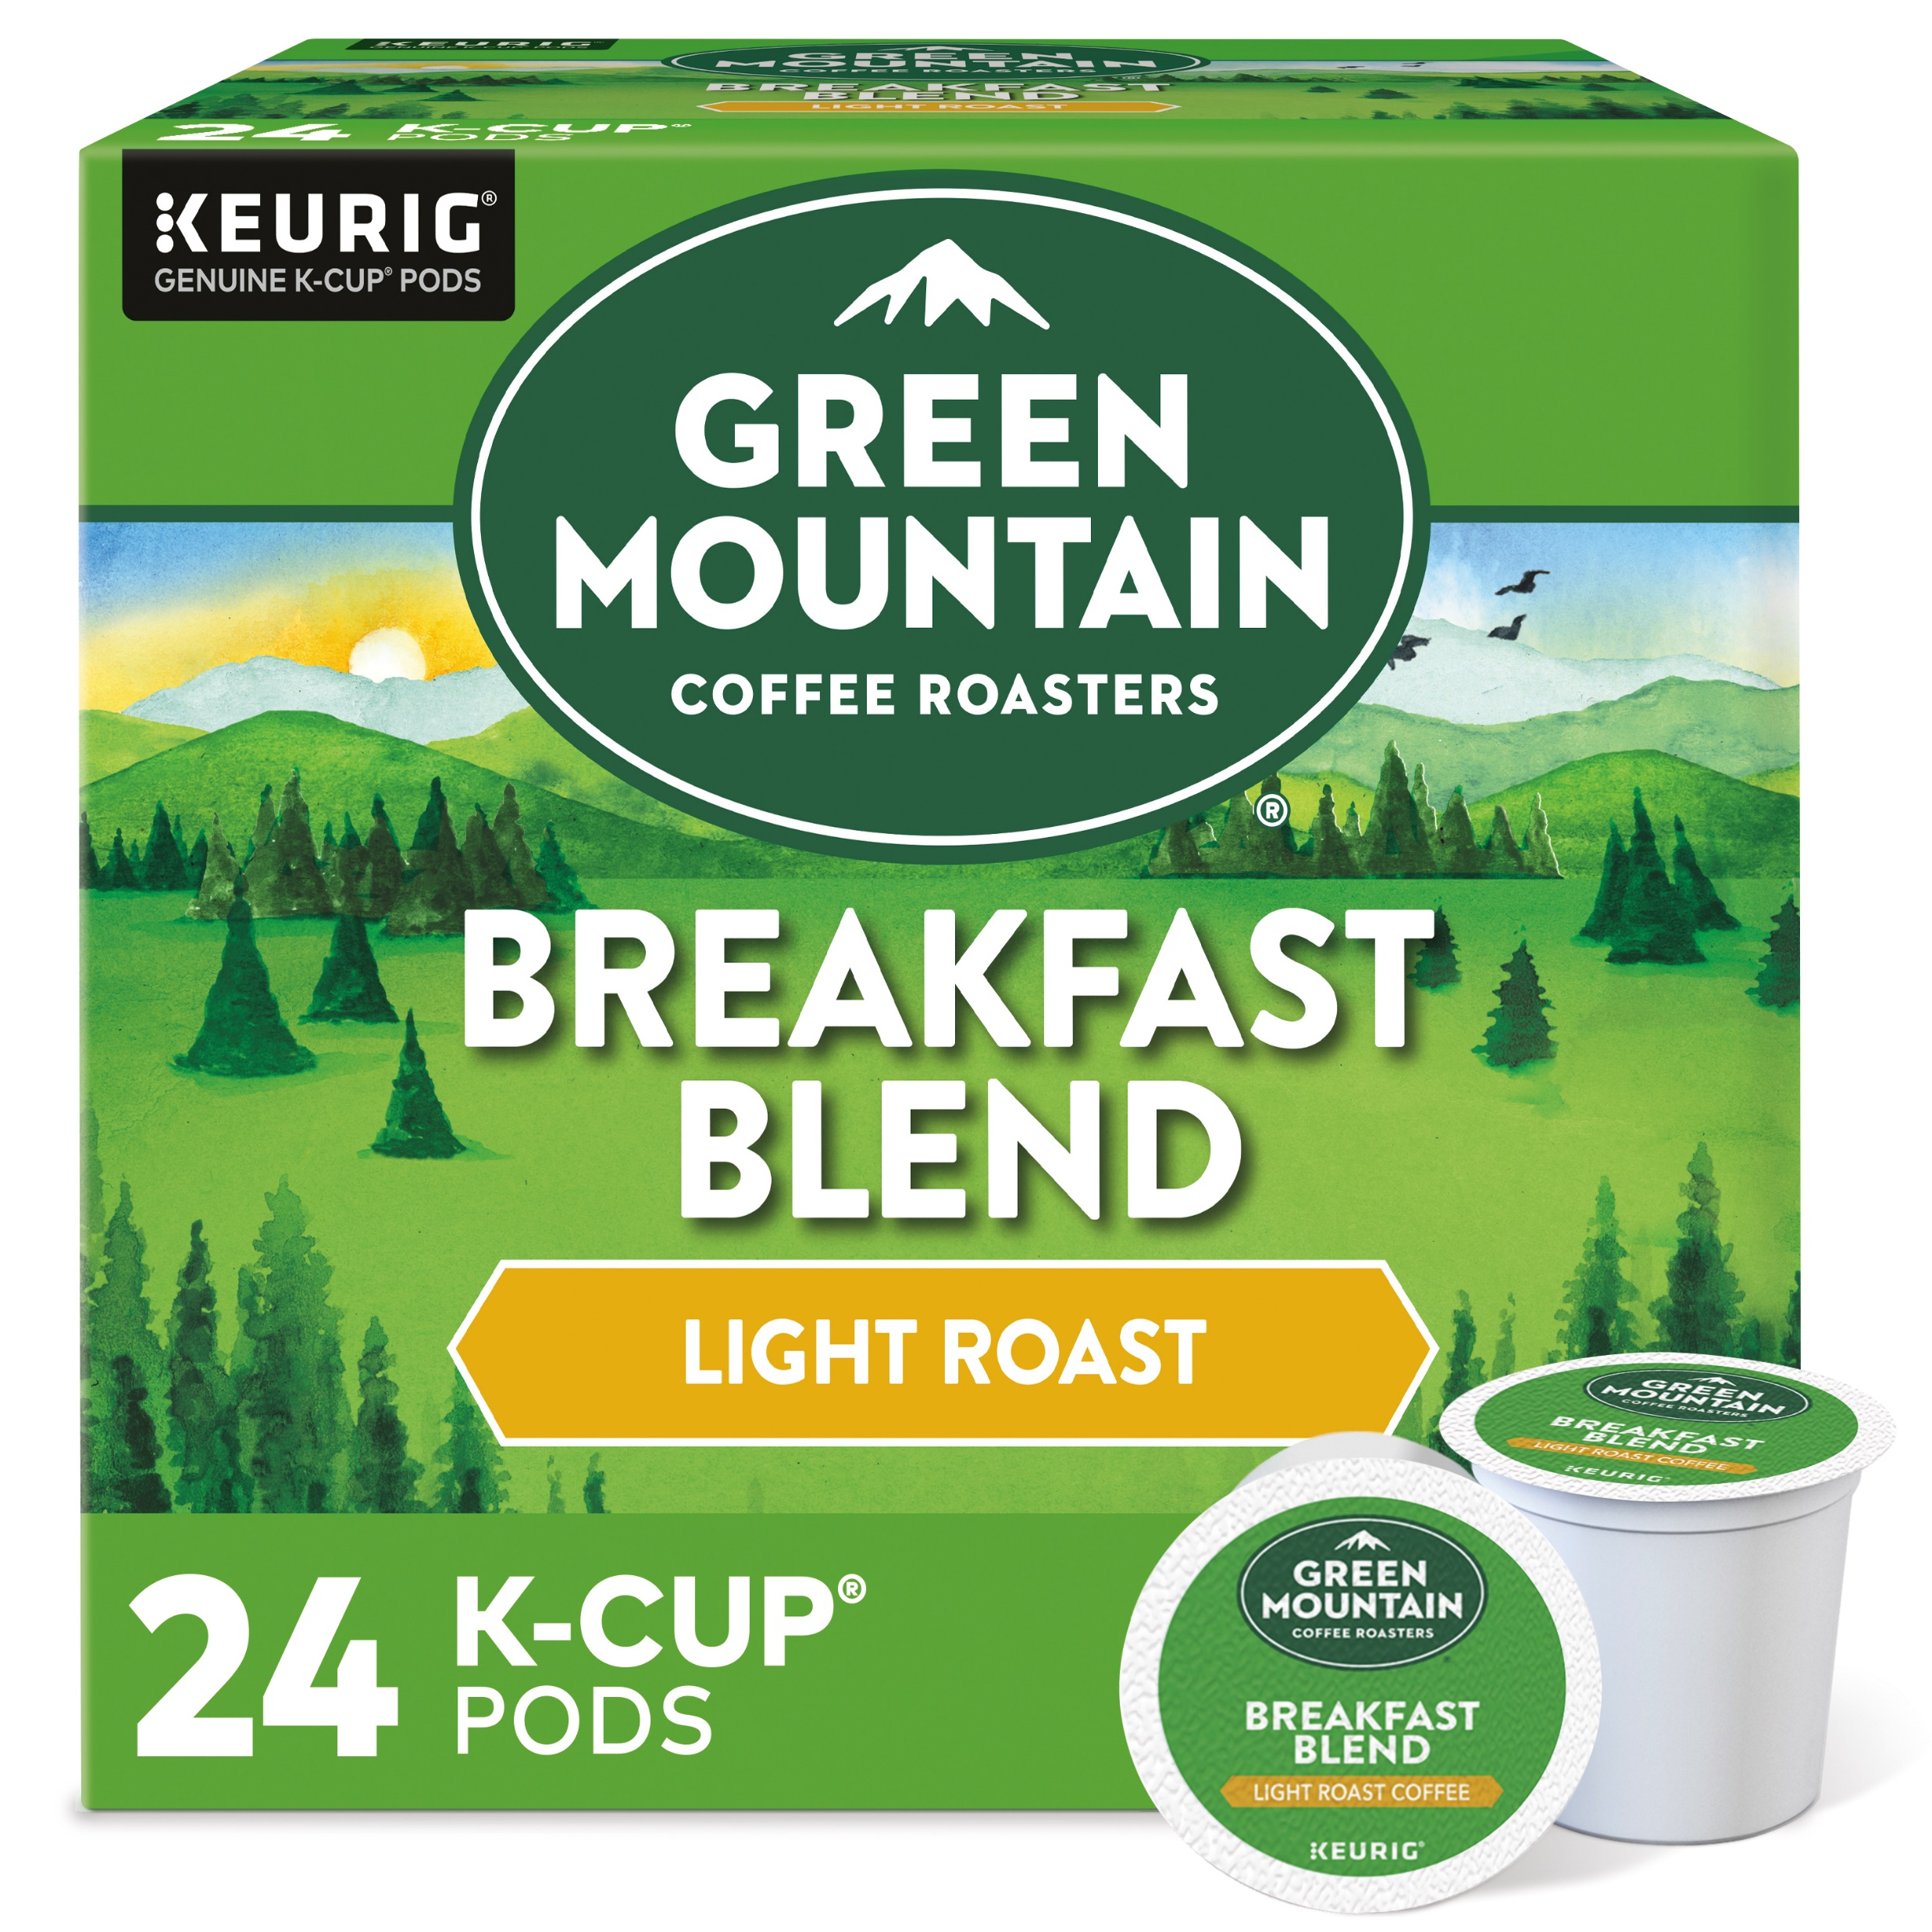
Reward Fulfillment
Congratulations, your data was approved!
At this point the process is completed and the user awaits their prize.
DataLucent checks the data for validity and the reward is sent to the user within 48 hours.
We can provide a push notification and/or email to ensure the user is aware their prize is ready.
Green Mountain Breakfast Blend – 24 Pack
Your reward will arrive in the mail. Please allow up to four weeks to receive your reward.

Slide 9
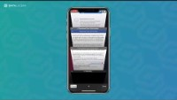
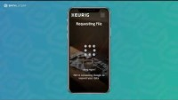
Video Walkthroughs
Before:
After:

